Slide 1
Visualisations of the Vicsek model
PX3017 Project
University of Aberdeen,
Alexander Groh,
24th of November 2019

Slide 2
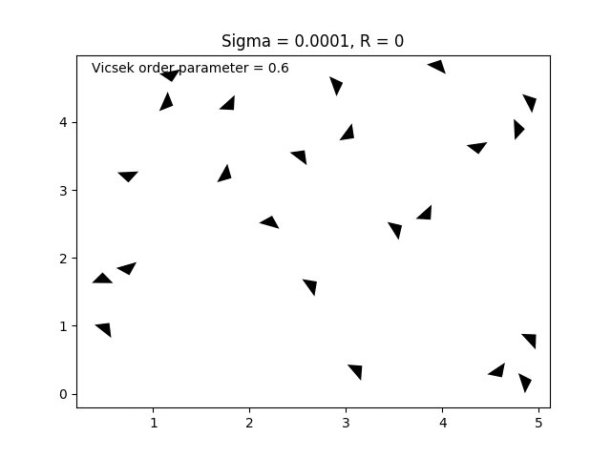
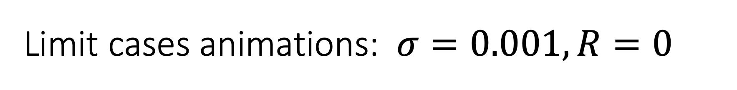
Limit cases animations: $σ=0.001, R=0$
the particles do not see each other, and no random noise is introduced, therefore they move only in straight lines and order parameter remains the same.

Slide 3
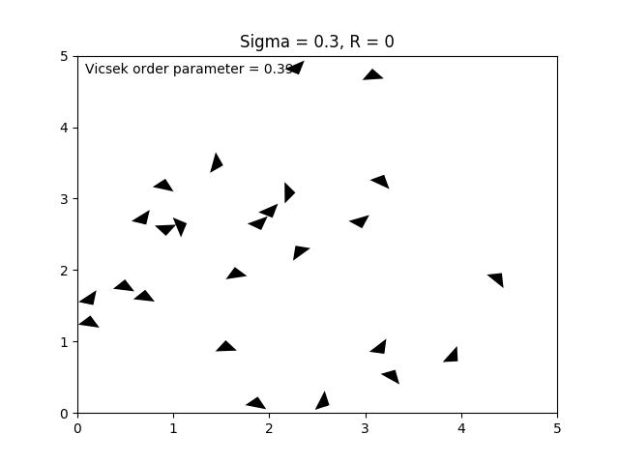
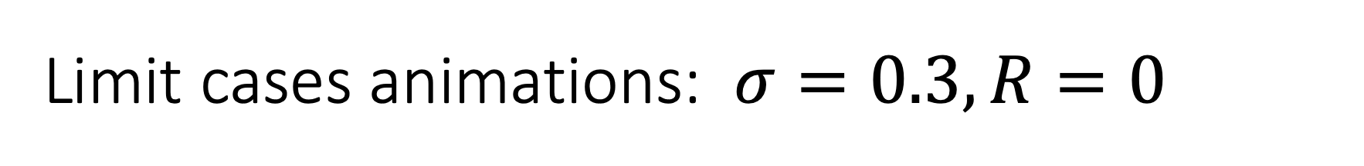
Limit cases animations: $σ=0.3, R=0$
the particles do not see each other, while low random noise is introduced, therefore they move in slightly distorted lines and order parameter randomly changes.

Slide 4
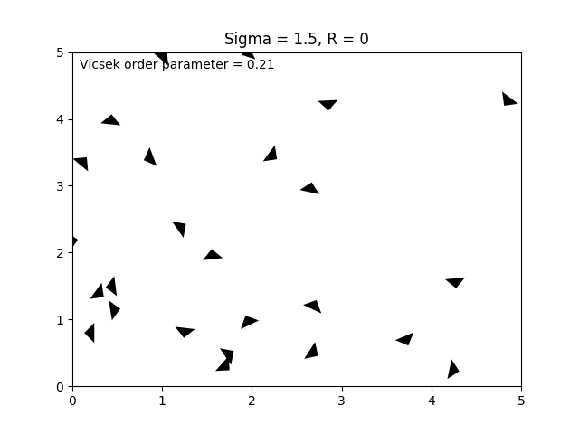
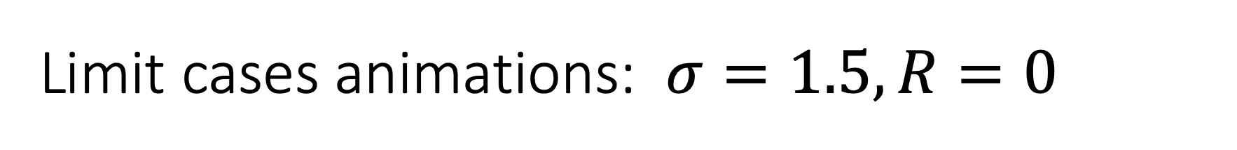
Limit cases animations: $σ=1.5, R=0$
the particles do not see each other, and higher noise is introduced, therefore they move in a random way and order parameter is generally very low and unstable.

Slide 5
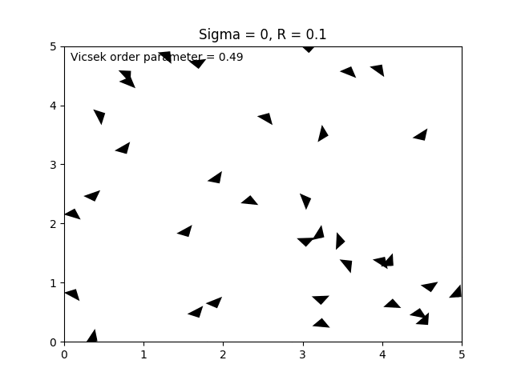
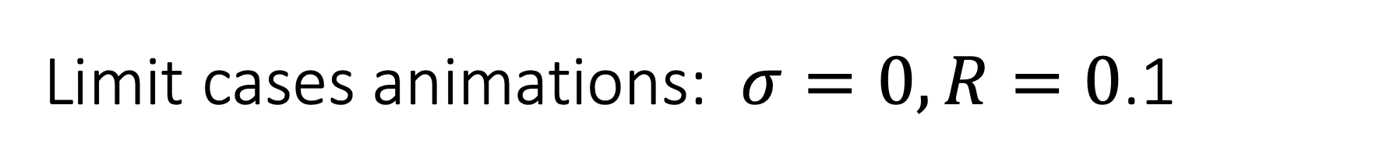
Limit cases animations: $σ=0, R=0$.1
the particles see each other on very short distance, with no noise. Therefore they move initially in a random way and only when they get very close to other bird they align. Order parameter only increases.

Slide 6
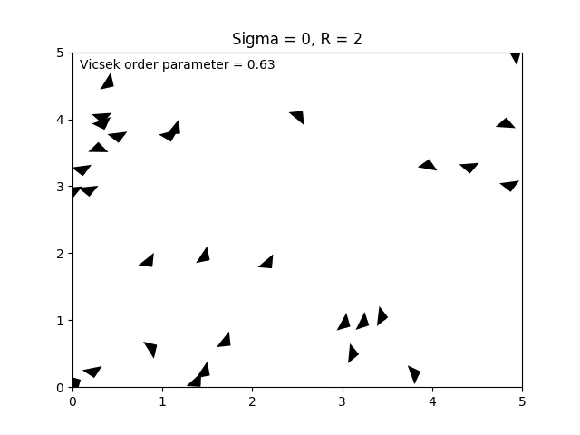
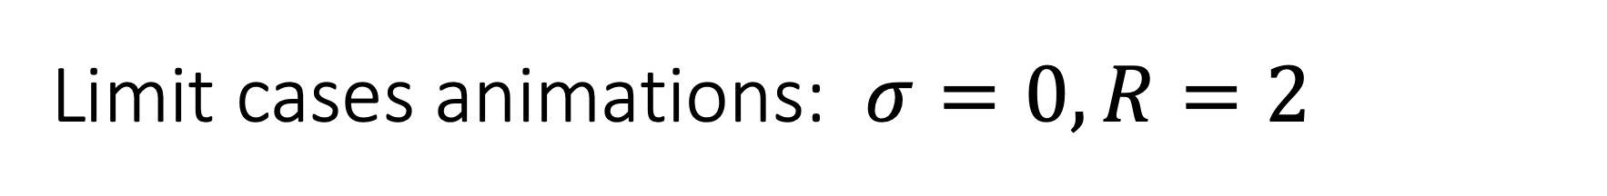
Limit cases animations: $σ=0, R=2$
the particles see each other on relatively large distances, with no noise. Initially, they move in a random way but in few steps they align ideally, with order parameter = 1

Slide 7
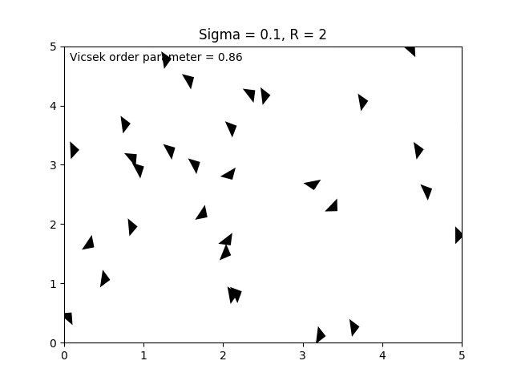
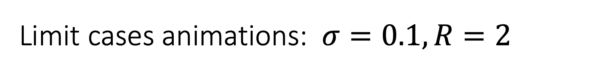
Limit cases animations: $σ=0.1, R=2$
the particles see each other on large distances, with low noise. Initially, they move in a random way they align quickly, but their mean direction is slightly changing, order parameter is close to 1

Slide 8
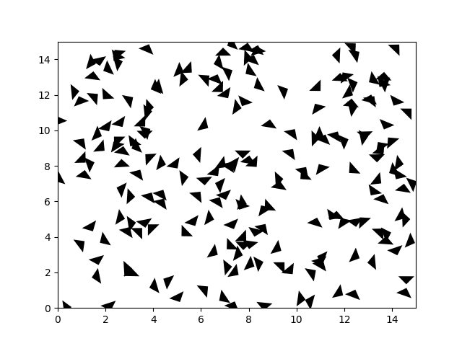
Animations for bigger flocks

Slide 9
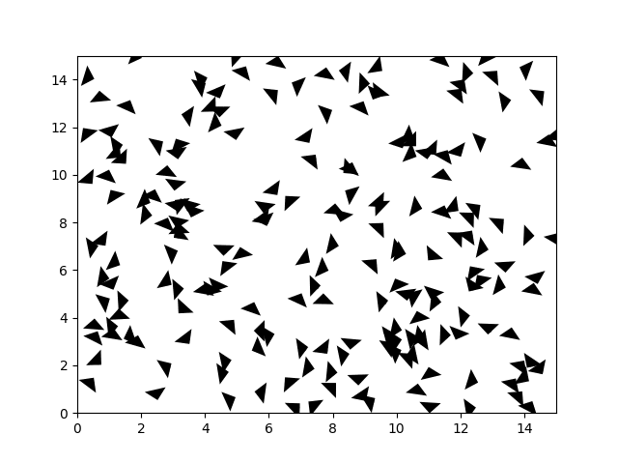
Animations for bigger flocks

Slide 10
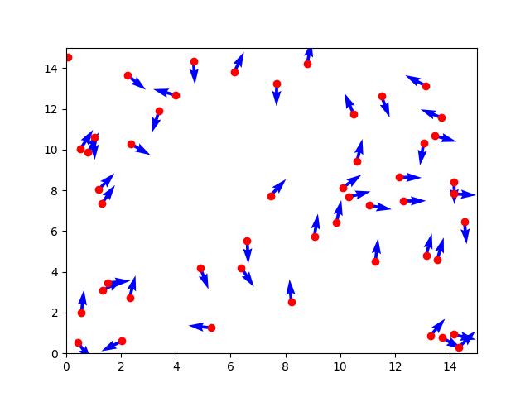
Animations for bigger flocks

